Slide 1
Intel Image Classification
Mohamed Zayyan Variawa

Slide 2
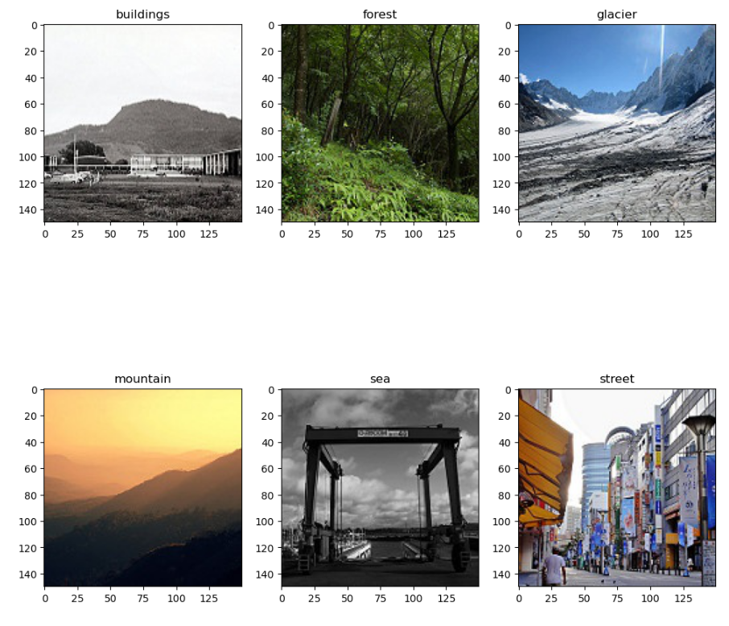
Context: The dataset contains about 17k images under 6 categories: buildings, forest, glacier, mountain, sea, street

Slide 3
Methodology
Data splits:
Train: 14K (20% validation split during training)
Test: 3K
Image pre-processing:
Rescale to [0,1] range
Horizontal flips
Vertical flips
Zoom range: 0.2
Sheer range: 0.2
Model hyper-parameters:
Optimizer: Adam
Learning rate: 0.001
Loss: Categorical cross entropy

Slide 4
Methodology
CNN architecture:
Layer | Filter size | #Filters | FC Units | Input
Conv. 1 | 3 X 3 | 16 | - | 3 X 150 X 150
MaxPool. 1 | 2 X 2 | - | - | 16 X 148 X 148
Conv. 2 | 3 X 3 | 32 | - | 16 X 74 X 74
MaxPool. 2 | 2 X 2 | - | - | 32 X 72 X 72
Conv. 3 | 3 X 3 | 64 | - | 32 X 36 X 36
MaxPool. 3 | 2 X 2 | - | - | 64 X 34 X 34
FC. 1 | - | - | 128 | 18 496
FC. 2 | - | - | 6 | 128

Slide 5
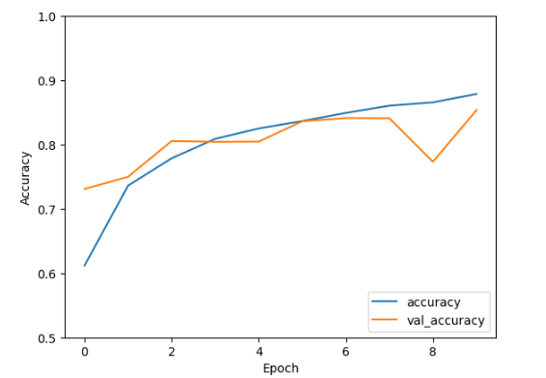
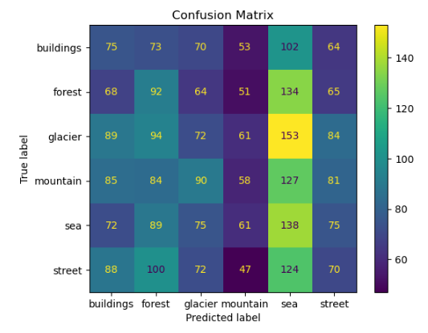
Results
Train vs Validation accuracy
Confusion Matrix

